Slide 1
Statistics and Probability of Tic-Tac-Toe
eval.winner <- function(board) { # Identify winner
square <- t(matrix(board, nrow = 3))
hor <- rowSums(square)
ver <- colSums(square)
diag1 <- sum(diag(square))
diag2 <- sum(diag(t(apply(square, 2, rev))))
if (3 %in% c(hor, ver, diag1, diag2)) return (1)
else
if (-3 %in% c(hor, ver, diag1, diag2)) return (2)
else
return(0)
}
# Random game
library(animation)
saveGIF ({
for (i in 1:10) {
game <- rep(0, 9) # Empty board
winner <- 0 # Define winner
player <- -1 # First player
draw.board(game)
while (0 %in% game & winner == 0) { # Keep playing until win or full board
empty <- which(game == 0) # Define empty squares
move <- empty[sample(length(empty), 1)] # Random move
game[move] <- player # Change board
draw.board(game)
winner <- eval.winner(game) # Evaulate game
player <- player * -1 # Change player
}
draw.board(game)
}
},
interval = 0.25, movie.name = "ttt.gif", ani.width = 600, ani.height = 600)

Slide 2
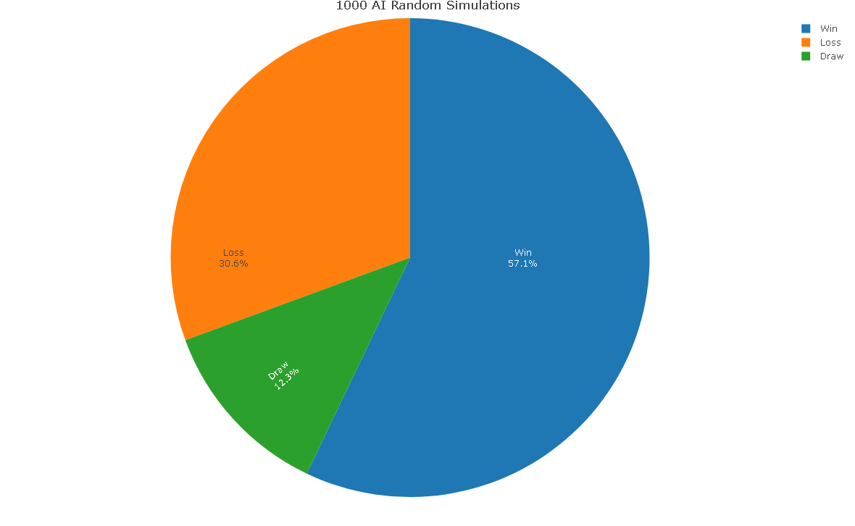
Win/Draw/Loss Ratio
##install.packages("tictactoe")
library(tictactoe)
result <- ttt_simulate(ttt_ai(), ttt_ai(), N = 1000, verbose = FALSE)
##See all results
print(result)
##See total probabilities
prop.table(table(result))
These Values are estimates and will change every simulation run (But not by much)

Slide 3
Different AI Skill levels
Player 1 Win/Draw/Loss |  | Player 1
 | Player 1 Win/Draw/Loss | Novice | Intermediate | Experienced | Expert
Player 2 | Novice | Win = 57.10% | Win = 90.40% | Win = 90.80% | Win = 97.80%
 |  | Draw = 12.30 % | Draw = 8.00% | Draw = 8.50% | Draw = 2.20%
 |  | Loss = 30.60% | Loss = 1.60% | Loss = 0.70% | Loss = 0.00%
 | Intermediate | Win = 6.40% | Win = 31.60% | Win = 35.50% | Win = 76.60%
 |  | Draw = 25.30% | Draw = 51.30% | Draw = 52.80% | Draw = 23.40%
 |  | Loss = 68.30% | Loss = 17.10% | Loss = 11.70% | Loss = 0.00%
 | Experienced | Win = 2.60% | Win = 16.10% | Win = 13.30% | Win = 27.10%
 |  | Draw = 21.00% | Draw = 73.60% | Draw = 85.90% | Draw = 72.90%
 |  | Loss = 76.40% | Loss = 10.30% | Loss = 0.80% | Loss = 0.00%
 | Expert | Win = 0.00% | Win = 0.00% | Win = 0.00% | Win = 0.00%
 |  | Draw = 20.40% | Draw = 83.90% | Draw = 98.30% | Draw = 100.00%
 |  | Loss = 79.60% | Loss = 16.10% | Loss = 1.70% | Loss = 0.00%

Slide 4
Probability of Winning?
1/9 Chance?

Slide 5
Center Probability
2/3 WIN
WIN!
2/3 WIN
4 + (2)(4) = 20
8 (3)(8) 24
WIN!
WIN!
2/3 WIN
2/3 WIN
WIN!

Slide 6
Corner Probability
WIN
WIN
7 = 21
8 24
WIN
TIE
WIN
WIN
WIN
WIN

Slide 7
Side Probability
(1)
24
TIE
TIE
TIE
TIE
TIE
TIE
TIE
TIE

Slide 8
Real Probability of Winning?
21/24
1/24
87.5%
21/24
4.17%
87.5%
20/24
1/24
83.3%
1/24
4.17%
4.17%
21/24
87.5%
1/24
21/24
4.17%
87.5%

Slide 9
Time to look at code!

